Slide 1

Cymraeg Campus
Bronze Award

Slide 2
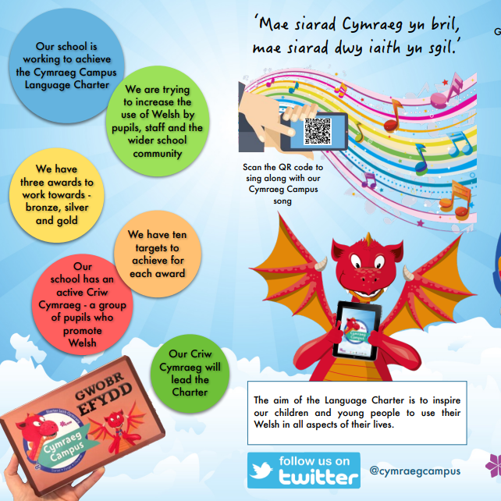

What is Cymraeg Campus?

Slide 3
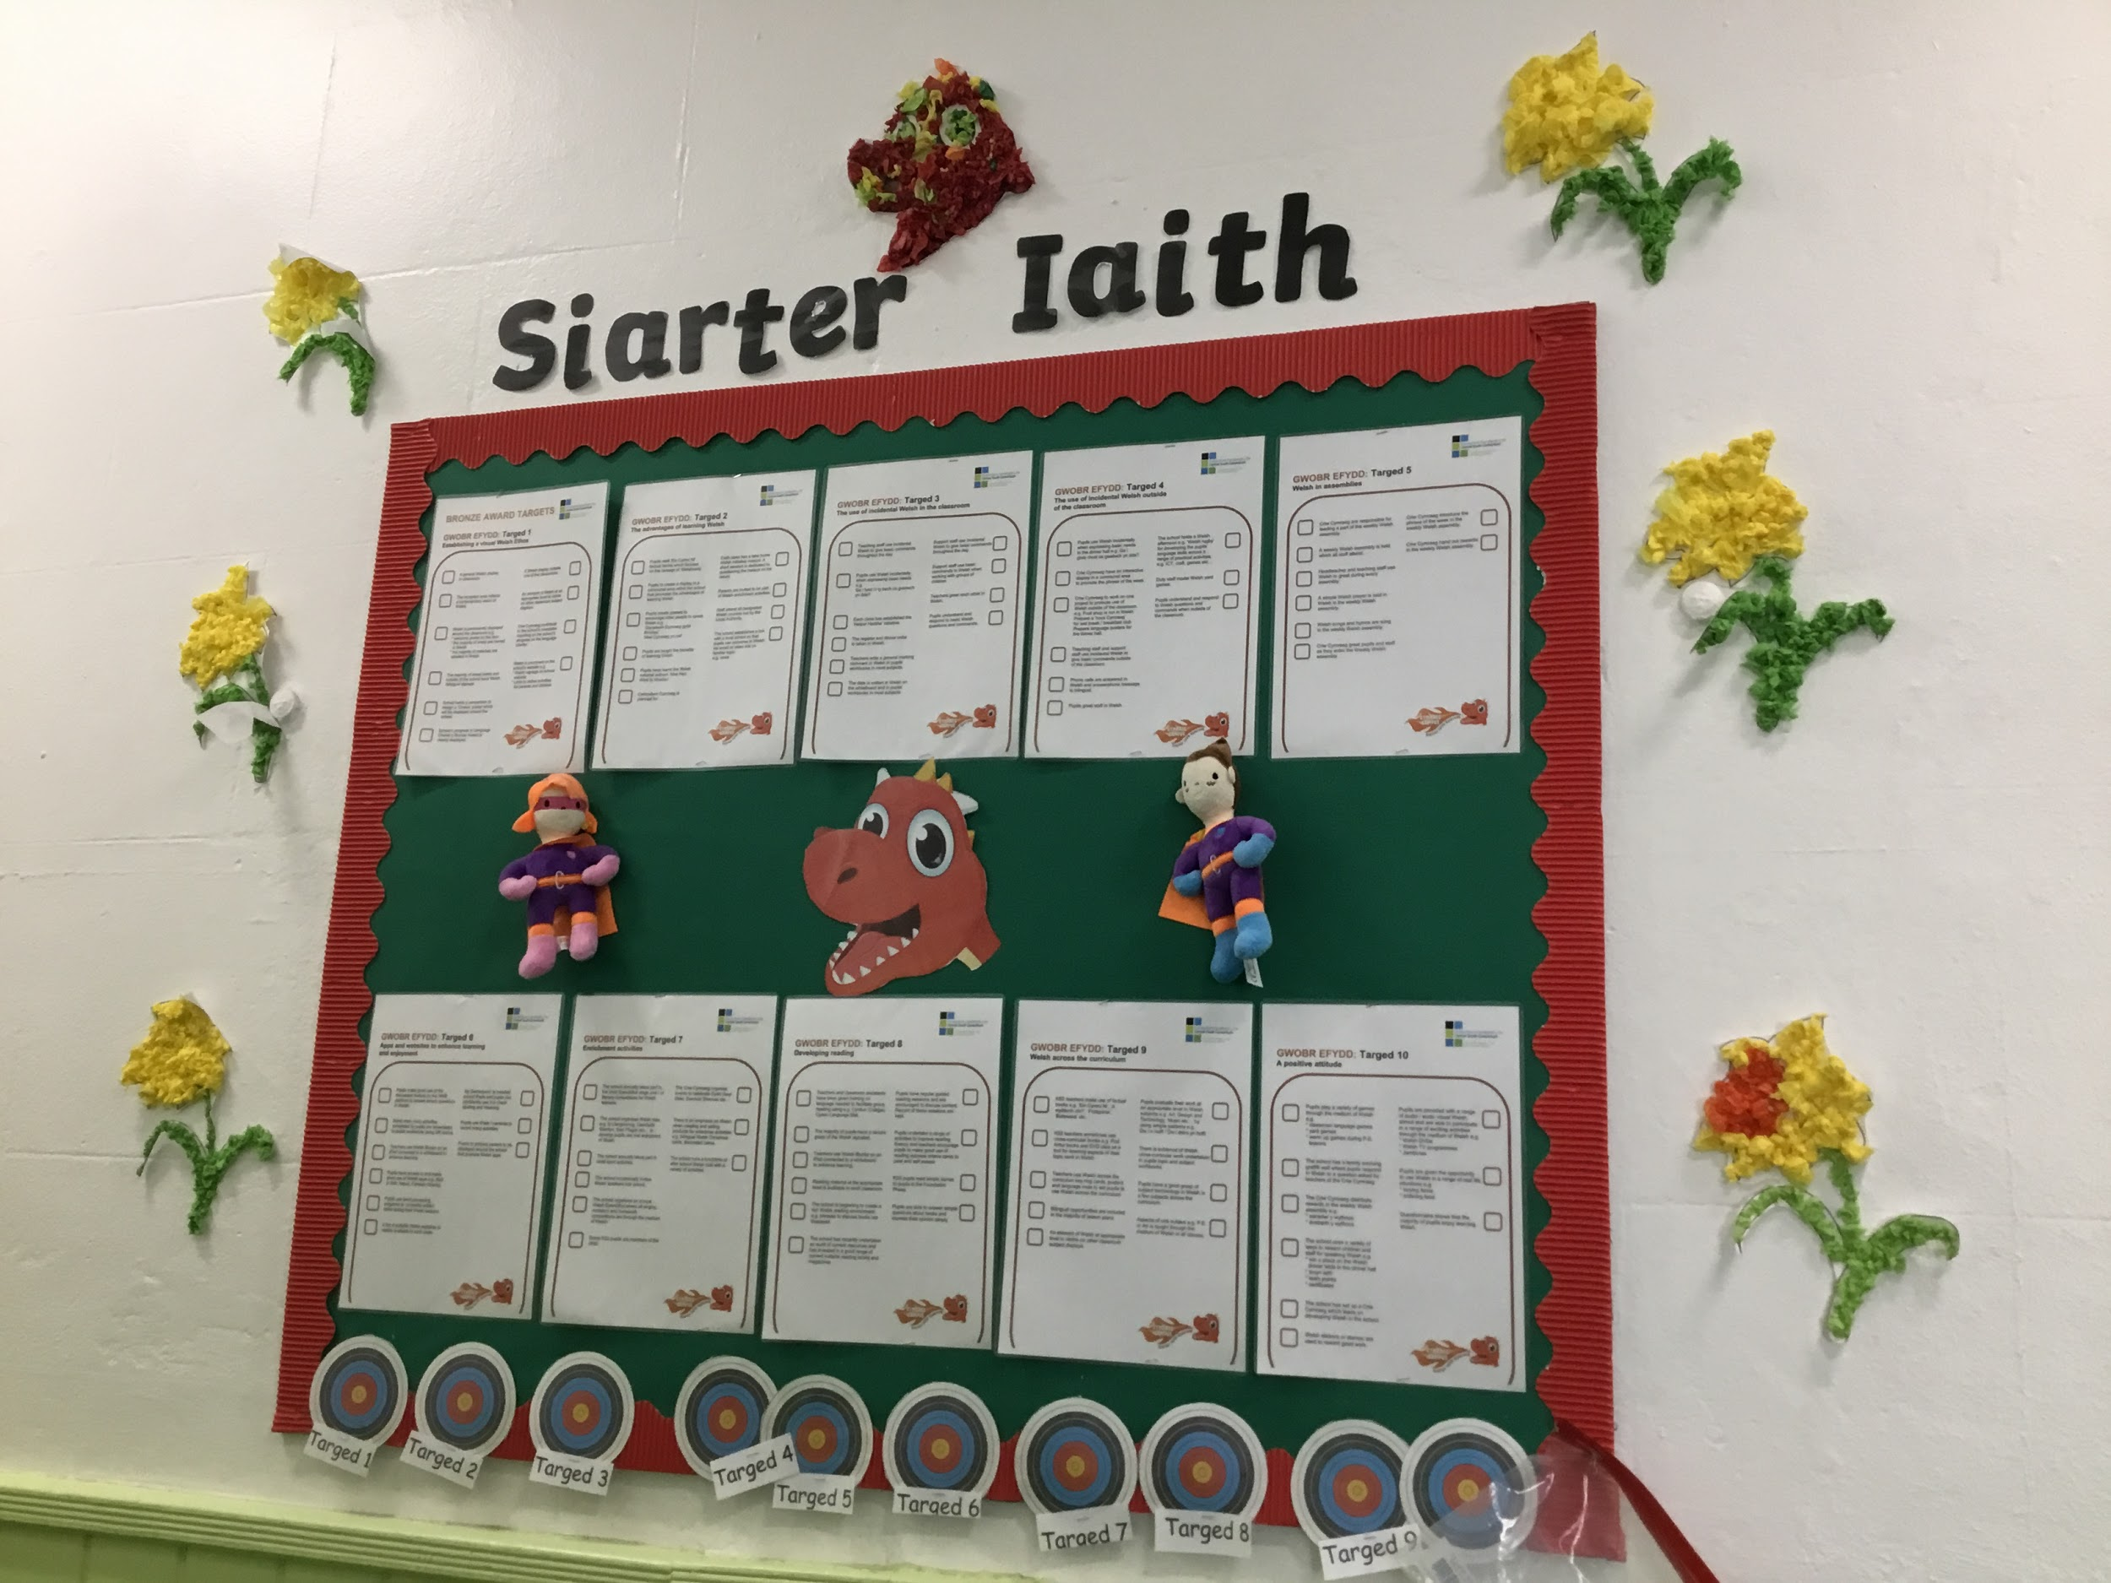
How can we get the Bronze Award?
To get the Bronze Award everyone in the school including all of the teachers and the children need to work together! ☺
The Criw Cymraeg will tick off each target when we get it. When we get 60% of each target we will stick a flame on top!

Slide 4

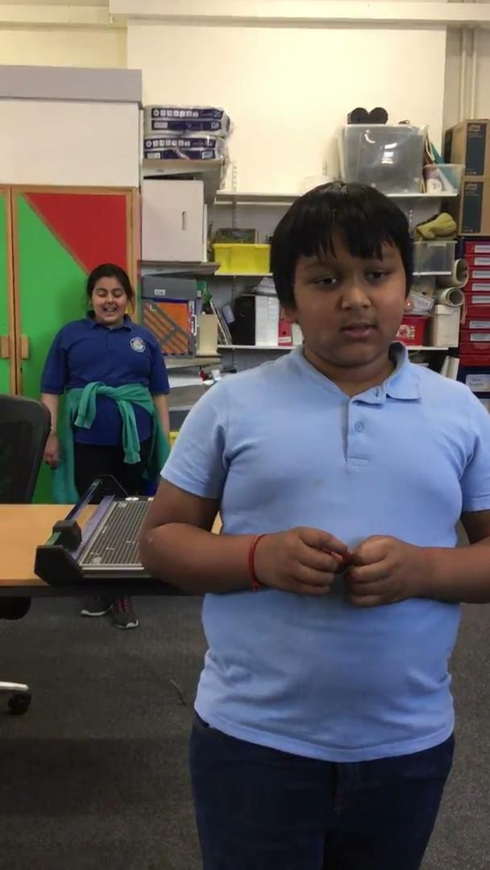
These are some examples of the
bronze award targets:
We already do some of these targets in school!
A general Welsh display in classrooms.
The register and dinner order is taken in Welsh
Teachers use incidental Welsh to give basic commands throughout the day.
School has a phrase of the week that is used throughout the school.
Phone calls are answered in Welsh
Children use ipads to record themselves speaking Welsh.

Slide 5
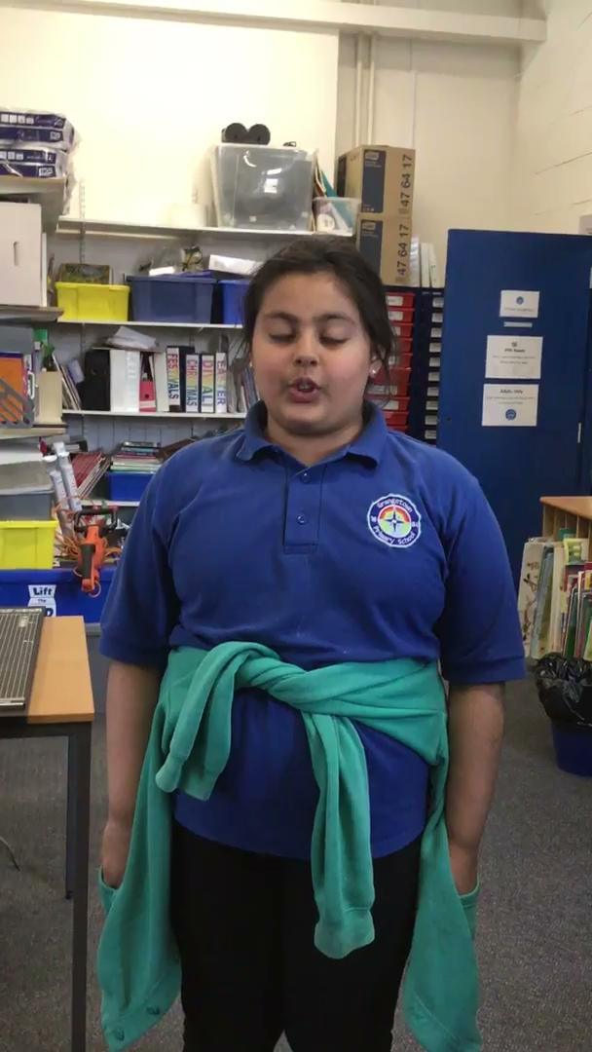
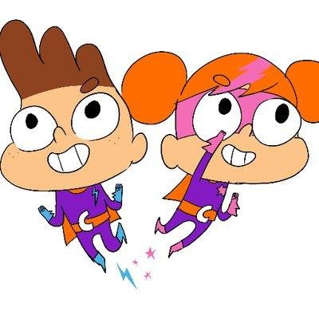
Seren a Sbarc
https://www.youtube.com/watch?v=HtvQBrjUBNg
Seren a Sbarc are our superhero mascots for the Siarter Iaith (Welsh Charter). They help pupils and staff in school to speak and use Welsh in and out of the classroom.

Slide 6
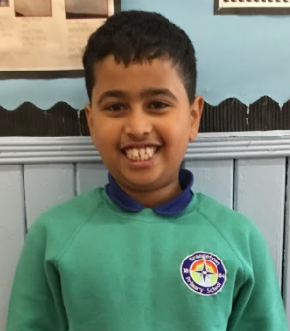
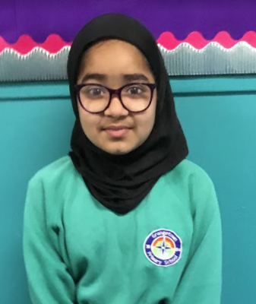
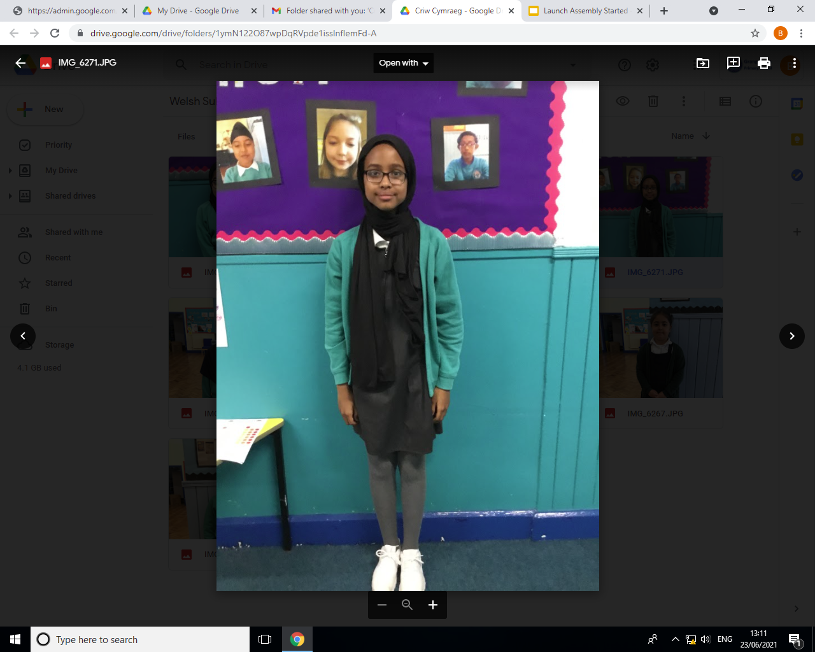
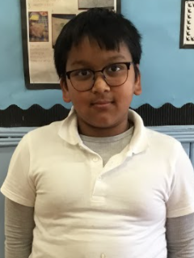
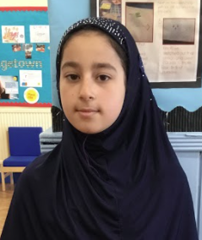
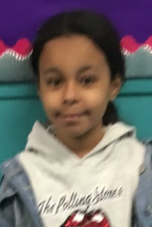
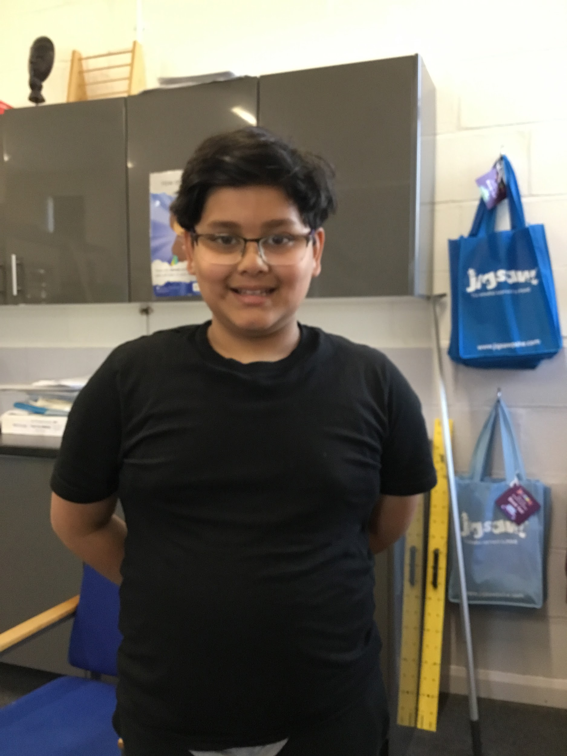
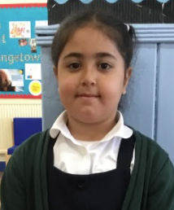
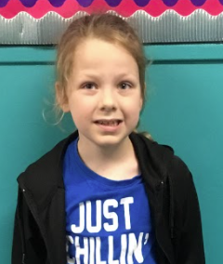
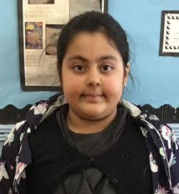
Criw Cymraeg
Helping in assembly
Handing out raffle tickets
Helped with the Eisteddfod
Listening for the phrase of the week
Listening for Welsh in class and around the playground

Slide 7
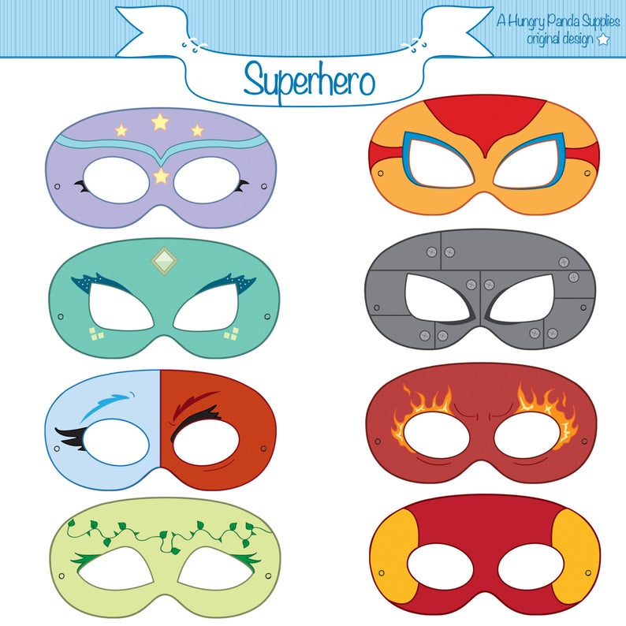
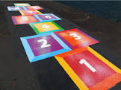
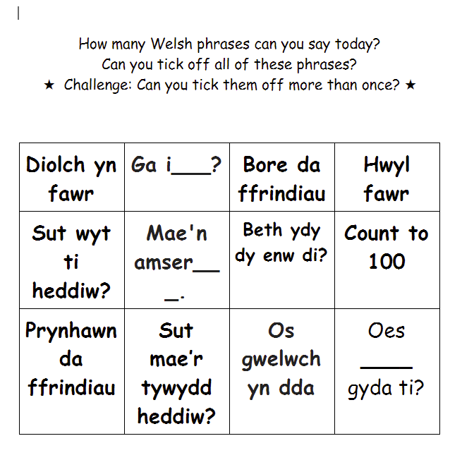
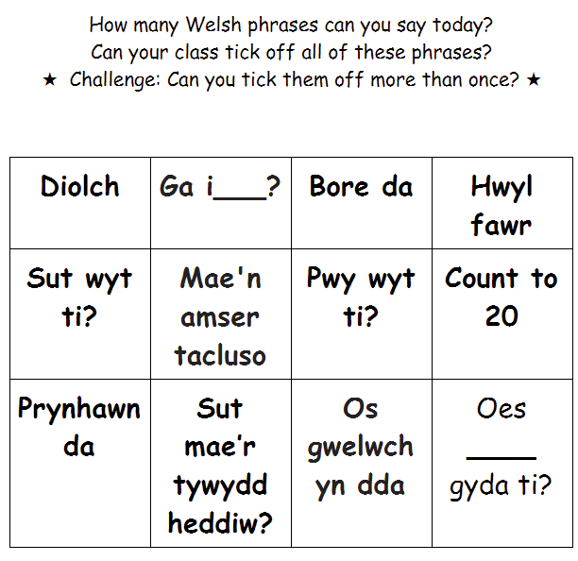
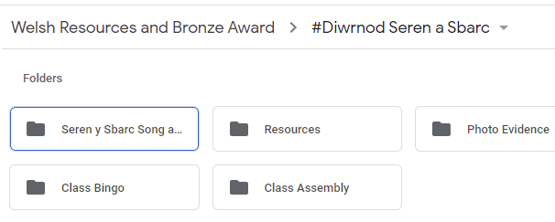
Here are some of the activities that you could do for our Seren a Sbarc day!
Design a Siarter Iaith / Cymraeg Campus logo - FP/KS2
Seren a Sbarc puppets and have Welsh conversations - FP
Make superhero masks - FP
Welsh comic strip/comic book featuring Seren y Sbarc - KS2
Create a new Welsh playground game - what Welsh words and phrases will we use? KS2
Play Welsh bingo
Please take lots of photos and videos of your Seren a Sbarc day and save in

Slide 8
Diolch!

