Slide 1

Welcome to
Year 3

Slide 2
Agenda
Meet the team
Attendance, punctuality and ordering lunch
Uniform
P.E
Oxford Reading
Maths
E-safety
UoL
ZoR
Questions

Slide 3
Team Year 3!
3G: Mrs O’Connell-Beech
3P: Miss Thompson - Monday, Tuesday, Thursday and Friday
3P: Mrs Herbert - Wednesday
Mrs Falzon
Miss Ali

Slide 4
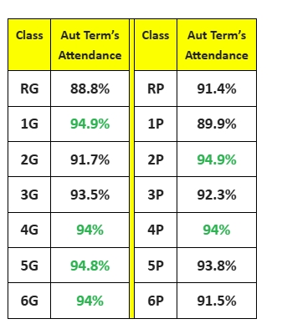
Attendance -

Slide 5
Attendance -
We are making a big push on attendance this year, as pupils’ attendance is dropping .
Already we have had a lot of absences. The attendance figures are shared with high schools and EWO. If children are ill, please keep them at home.
Children need to be in by 8.55am, and this is when gates are closed.
Only 35% of pupils whose attendance is lower than 90% gain 5 or more GCSEs including England and Maths.
Students with 100% attendance have almost 75% chance of gaining 5 or more GCSEs at grades 5-9 including English and Maths.

Slide 6
Uniform
Our expectations in the school are that pupils wear school uniform.
In past times, school uniform might have been expensive, but there is so much support now through grants, recycling/ reusing and similar schemes that we are hoping everyone comes into school with uniform.
If you have any questions about the schemes, please see our Family Engagement Officer, Maria Sajid, and she will be able to help you.

Slide 7
P.E
Our P.E day is every Wednesday. Children will need to come into school already in their P.E kit. This includes an appropriate t-shirt, jumper (if colder), shorts, jogging/ tracksuit bottoms and APPROPRIATE footwear.
No jeans are to be worn.
PE is a curriculum expectation - all children have to participate.
Just a reminder we will ask children to take out to remove hooped earrings, necklaces and any other jewellery as it is a health and safety risk.
Sports day - Wednesday 25th at 2pm. Enter through the red gate.

Slide 8
Reading
All children have access to Oxford Owl reading buddy. This is an online library which allows children to choose a variety of books in school and at home to read. They need to read AT LEAST one Oxford Reading Buddy book a week and complete the comprehension.
Your child should also read their home reader once a week.
Also, your local library is at the hwb in Grangetown, by the crossroads. However, if it is quite difficult to get to, they now offer something called borrowbox.

Slide 9

https://www.oxfordreadingbuddy.com/uk

Slide 10
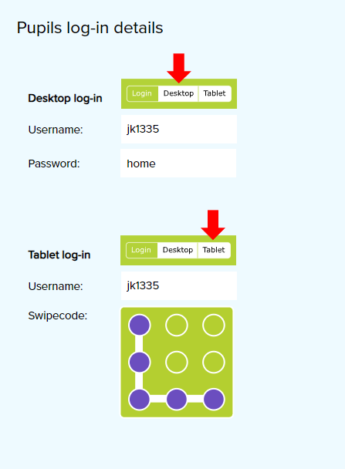
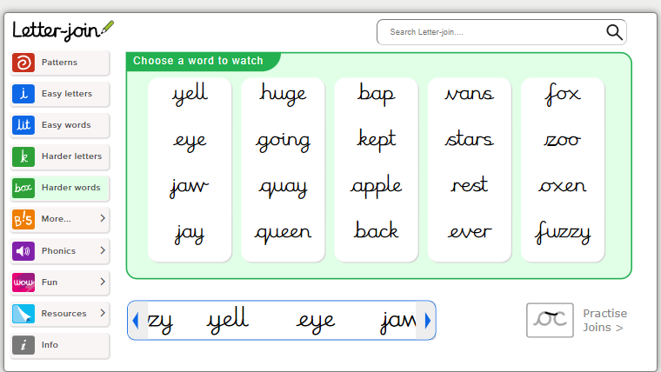
Letterjoin

Slide 11


Slide 12
You are invited to join us once a month in our KS2 library
Choose a book and enjoy some refreshments
January
Year 3 20th January - 2.15 | Year 4 21st January - 2.15 | Year 5 22nd January - 2.15 | Year 6 23rd January - 2.15
February
Year 3 12th February - 2.15 | Year 4 11th February - 2.15 | Year 5 13th February - 2.15 | Year 6 14th February - 2.15

Slide 13

Maths
Children in year 3 are just at the start of their learning using Google classroom, for children to access to help improve their maths.
We take Big maths test weekly, and the expectation is that children aim to move up 3 per year. Children can check their scores online and work on what they need to improve their scores. They can do this by asking a teacher, asking parents, taking ownership of their own learning.
Our current maths topic is place value.

Slide 14
Useful maths links
https://www.topmarks.co.uk/maths-games/hit-the-button
https://mathsframe.co.uk/
https://ictgames.com/mobilePage/index.html
https://www.topmarks.co.uk/maths-games/7-11-years/place-value
https://www.topmarks.co.uk/maths-games/daily10

Slide 15


E Safety
Supervise children when using devices
PEGI Ratings - check the age rating on apps and games
Screen time
Staying safe online - we will be covering this throughout the year ,but if you need any support please just ask.
E Safety guidance
https://saferinternet.org.uk/guide-and-resource/parents-and-carers
https://www.internetmatters.org/

Slide 16

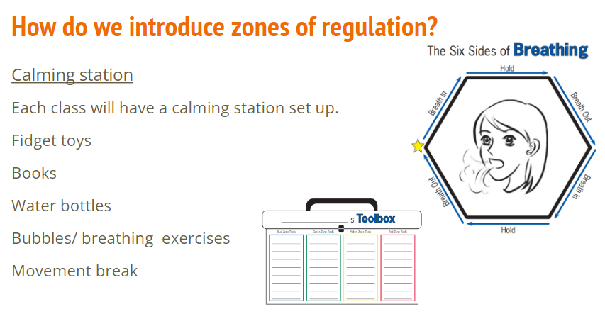
Zones of Regulation

Slide 17
Our River Visions
On Tuesday 14th January at 9:30-10:15 in the KS2 hall , the children will be presenting their learning from UoL 2.
They will be sharing with you what they have learnt and their vision for Rivers in Cardiff and all around the world.
We hope you can all make it :)

Slide 18





Unit of Learning 3 - Story listener, teller, maker.
Pupils will be able to independently use their learning to: SWUT: Using their knowledge of journey stories, children will create pieces of art that are inspired by the story settings they have read, and one they have written.
Present learning through creating simple story books illustrated by multi-media landscapes/settings

Slide 19
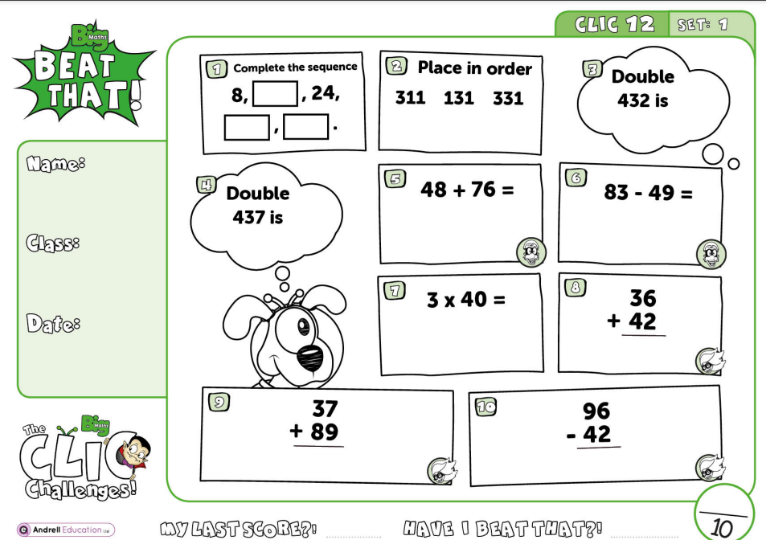
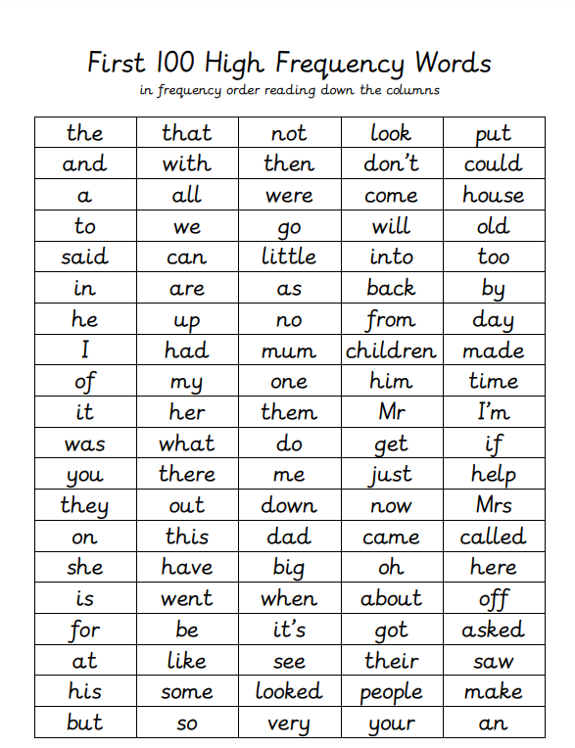
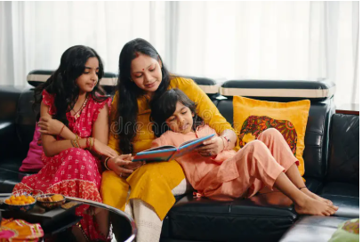
Please help your child by :
You help them practise their maths
Your child should be able to read these words and also spell them correctly.
Listen to them read for 10 minutes each day.

Slide 20
Letterjoin
Letterjoin
Letterjoin

