Slide 1

Welcome to
Year 4

Slide 2
Agenda
Attendance, punctuality and ordering lunch
Uniform
P.E
Oxford Reading
Maths
E-safety
UoL
Questions

Slide 3
Attendance
We are making a big push on attendance this year, as pupil’s attendance is dropping and particularly our year group. Already we have had a lot of absences. The attendance figures are shared with high schools and EWO. If children are genuinely, ill please keep them at home.
Children need to be in by 8.55 and this is when gates are closed.
Only 35% of pupils whose attendance is lower than 90% gain 5 or more GCSEs including England and Maths.
Students with 100% attendance have almost 75% chance of gaining 5 or more GCSEs at grades 5-9 including English and Maths.

Slide 4
Uniform
Our expectations in the school are that pupils wear school uniform.
We get that in past times that school uniform might have been expensive, but there is so much support now through grants, recycling/ reusing and similar schemes that we are hoping everyone comes into school with uniform.
If you have any questions about the schemes, please see our Family engagement officer and she will be able to help you.

Slide 5
P.E
Our P.E day is every Tuesday after this week, children will need to come into school already in their P.E kit. This includes an appropriate t-shirt, jumper (if colder), shorts, jogging/ tracksuit bottoms and APPROPRIATE footwear.
PE is a curriculum expectation - all children have to participate.
Just a reminder we will ask children to take out to remove earrings, necklaces and any other jewellery as it is a health and safety risk.

Slide 6
Swimming
Swimming will take place in June
All children are expected to learn to swim during their primary education
No swimming experience is needed.
They will need: swim wear, towel, goggles

Slide 7
Reading
All children have access to Oxford Owl reading buddy. This is an online library which allows children to choose a variety of books in school and at home to read.
Also, your local library is at the hwb in Grangetown, by the crossroads. However, if it is quite difficult to get to, they now offer something called borrowbox.

Slide 8
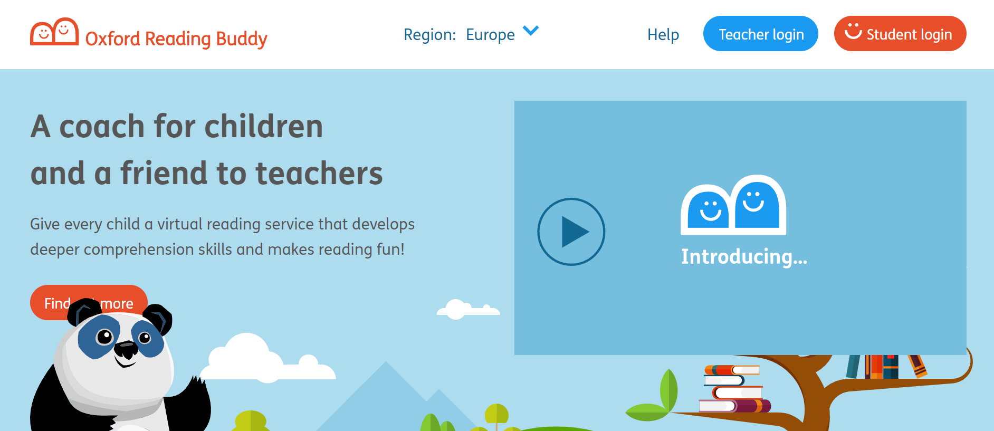
https://www.oxfordreadingbuddy.com/uk

Slide 9
School code
q22qq

Slide 10
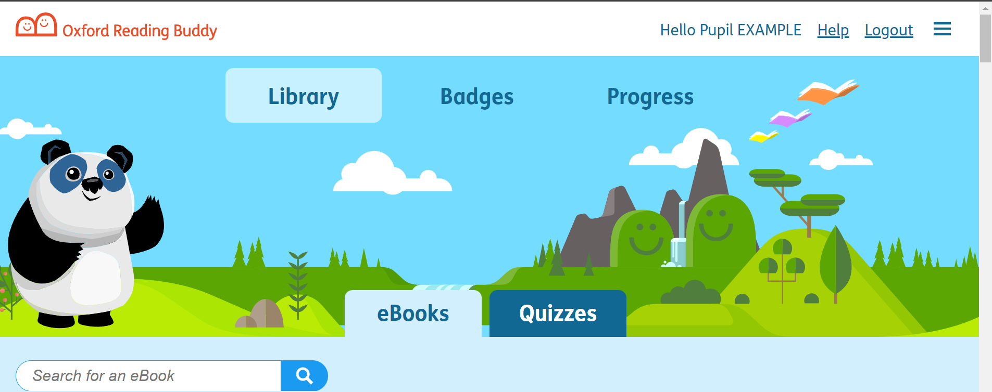
This is the home page - the library

Slide 11
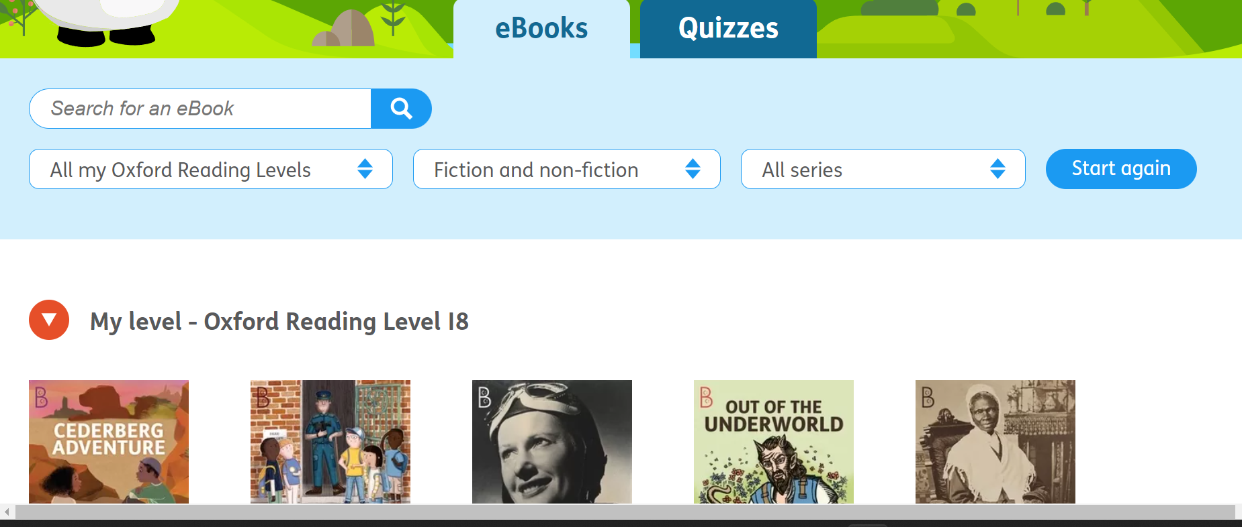
Your child’s current level will be at the top

Slide 12

Some books have this red logo. This means the book give the children advice on how to understand their reading.

Slide 13
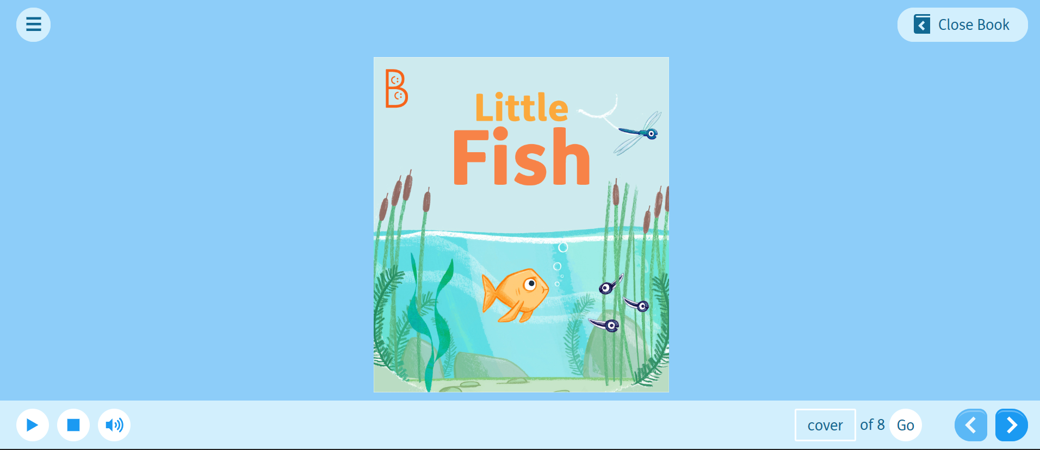
Books up to level 10 have an audio option to listen to the story

Slide 14
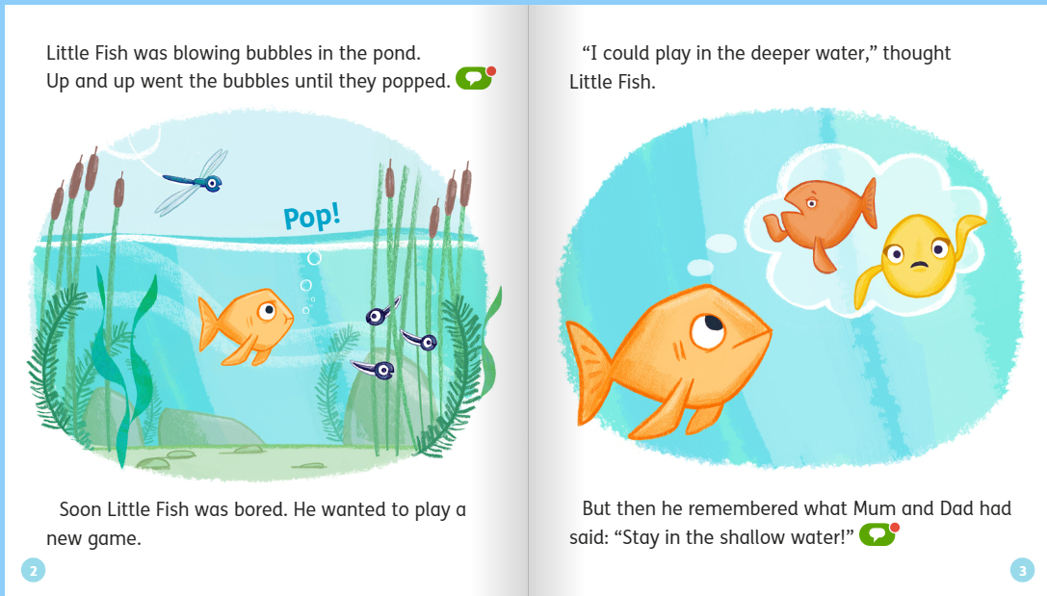
Green speech bubbles give the children things to think about or discuss.

Slide 15
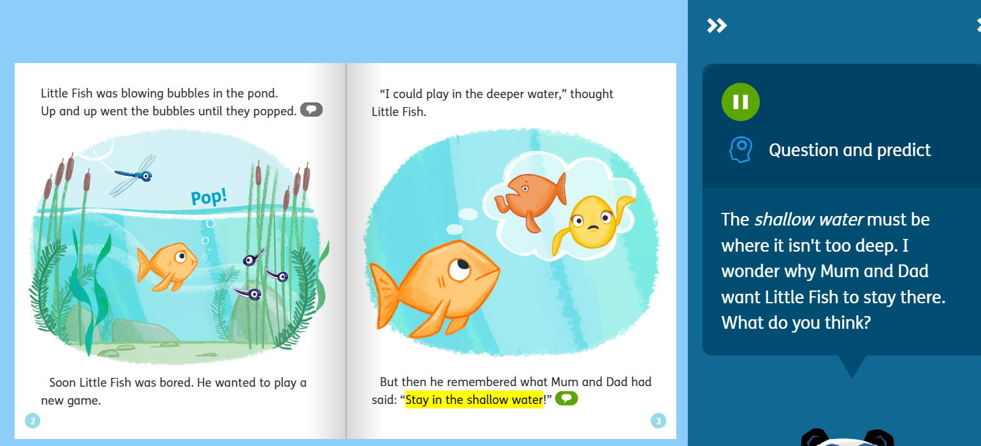

Slide 16
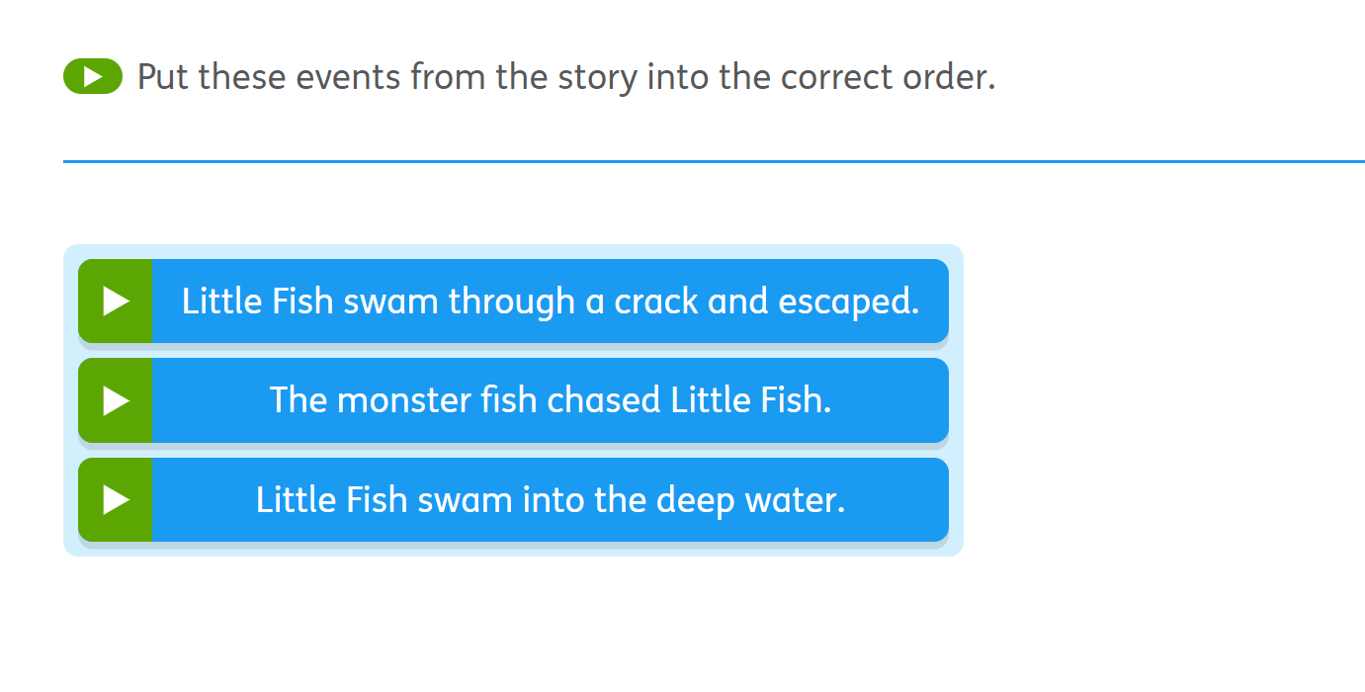
Quiz questions

Slide 17
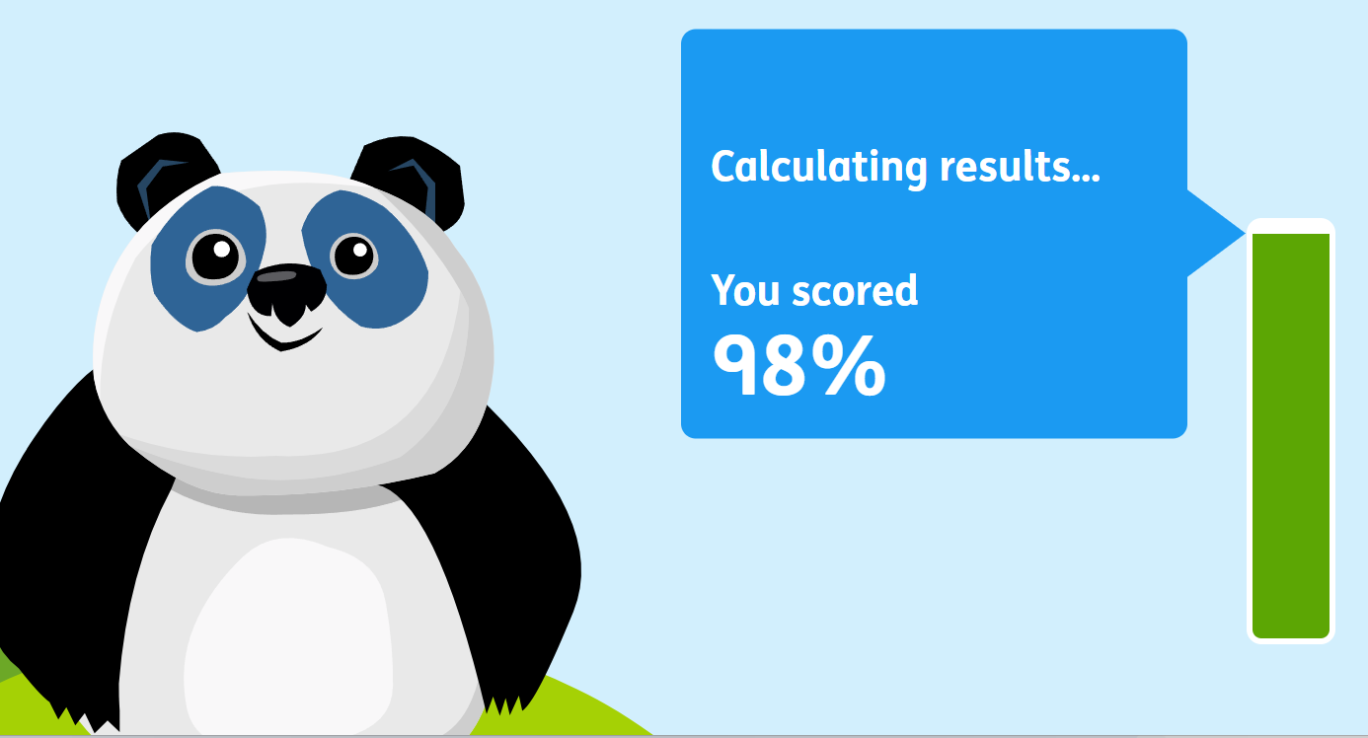
After the quiz, it gives you your score.

Slide 18

Maths
Online packs are being put on Google classroom, where children can access to improve their maths.
We take Big maths test weekly, and the expectation is that children aim to move up 3 per year. Children can check their scores online and work on what they need to improve their scores. They can do this by asking a teacher, asking parents, taking ownership of their own learning.

Slide 19
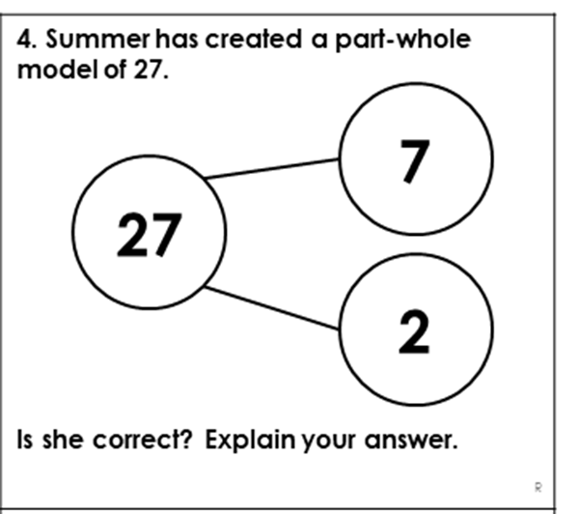
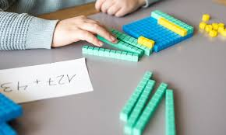
Maths approach - 5 proficiencies
Our approach to maths is slightly different to how we used to teach.
The 5 proficiencies allows the children to:
have a better understanding of maths through exploring equipment
showing their thinkinging using diagrams
having a secure understanding of basic maths concepts.
Relate maths to real life situations

Slide 20
Useful maths links
https://www.topmarks.co.uk/maths-games/hit-the-button
https://mathsframe.co.uk/
https://ictgames.com/mobilePage/index.html
https://www.topmarks.co.uk/maths-games/7-11-years/place-value
https://www.topmarks.co.uk/maths-games/daily10

Slide 21
Esafety
PEGI ratings
Screen time
Online gaming and dangers it brings
Reporting anything online

Slide 22

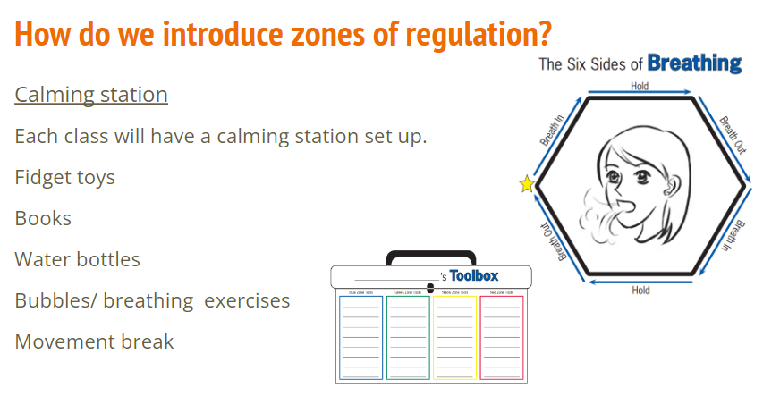
Zones of Regulation

Slide 23
Unit of Learning
What we will be teaching the children
Body Ready Brain Ready
No Planet B -Trees
Exploring imagination
Children’s rights and how they have changed
Why we are teaching the children these things
Develop their global understanding
Become more ethically informed
Become more independent learners
Express themselves through a variety of curriculum opportunities

Slide 24
Trips
Any parents who are willing to come on trips are very much appreciated. Please let us know if you are happy to support with this.

Slide 25
Questions

